Slide 1



Starting Now
The Role of Synthetic Data in LLM Development
Synthetic data offers scalable and economical LLM development.
This session delves into its wide-ranging use cases.
- Accelerate data curation
- Enable LLM distillation
- Improve model robustness
- Align outputs with user preferences
Eslam Kamal
Engineering Manager
AI @ Meta Platforms

Slide 2

The Role of Synthetic Data in
LLM Development
Enabling scalable and economical LLM training

Slide 3
About Eslam Kamal
AI Engineering Manager with 18+ years of professional experience
Currently at Meta Platforms, Ex-Microsoft
Focus areas include Multimodal LLMs, Conversational AI, NLP, Responsible AI and ML data strategies
Responsible for the conversational quality of Live AI models on Ray-Ban Meta smart glasses and next-gen smart wearables at Meta
Led AI engineering teams for Azure Responsible AI, Microsoft Copilot, GitHub Copilot, Copilot Studio, Dynamics 365 and Azure AI Language
Author of “Data Strategy for LLMs” book (stay tuned)
Husband and father of two: 16-years-old girl and 13-years-old boy
Hobbies: table tennis, video games, and board games
Eslam Kamal
Engineering Manager
AI @ Meta

Slide 4
Agenda
01
Introduction to Synthetic Data
02
Accelerating Data Curation
03
Synthetic Data in LLM Distillation
04
Preference Alignment Case Study
05
Building Robustness with Synthetic Data
06
Q&A

Slide 5
Section 1: Introduction to Synthetic Data

Slide 6
Introduction to Synthetic Data
What is Synthetic Data?
Artificially generated data that mimics real-world examples, typically created by models or algorithms
Types of synthetic text data
  Prompted generation using LLMs with strong prompting
  Simulated conversations or question-answer pairs
  Paraphrased or templated sentences
Synthetic data could be essential when
  Collecting real-world data is slow, costly, or restricted
  Simulating edge cases or rare linguistic patterns
  Working with harmful content
Multimodal synthetic data
  Combine text with images, audio, or video generated by models
  Enables training of vision-language models using paired text
>
Pg: 6
Notes:
Talking Points:
Used where collecting real-world data is slow, costly, or restricted.
Can simulate edge cases or rare linguistic patterns.
Increasingly reliable with strong prompting techniques.

Slide 7
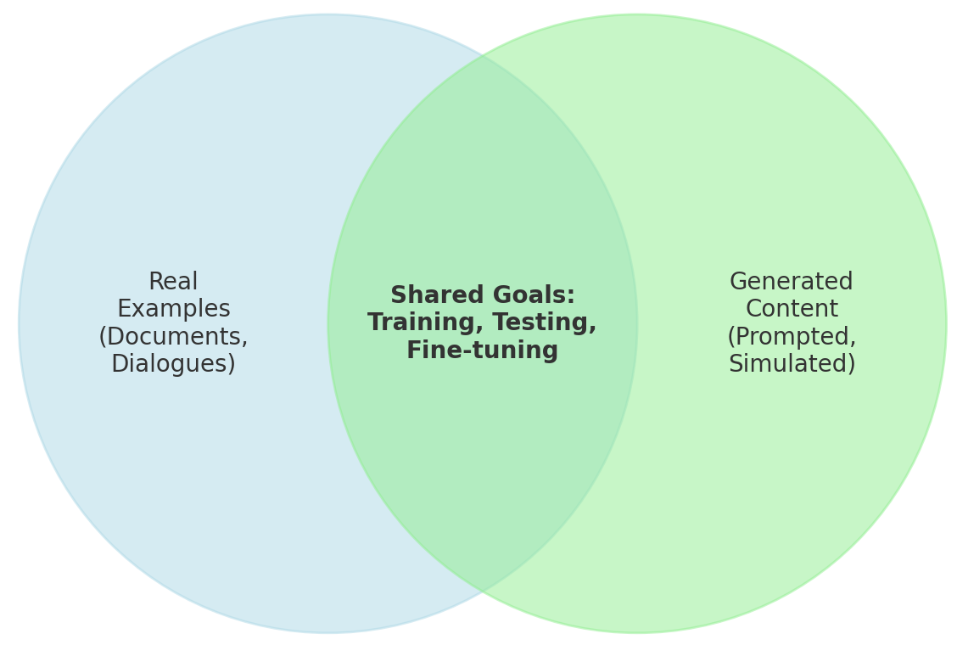
Introduction to Synthetic Data
Why Synthetic Data?
Scalability
Generate millions of samples on demand
Efficiency
Reduces manual labeling effort and workforce costs and increases throughput
Control
Tailor data to specific tasks, languages, or domains
Privacy
Real data and synthetic data have overlapping roles in training, testing, and fine-tuning
No real user data required — critical for sensitive domains and enterprise scenarios
>
Pg: 7
Notes:
Talking Points:
Best AI models use synthetic supervision (e.g., RLHF, pre-training, preference alignment).
Use in complement, not as a total replacement.

Slide 8
Section 2: Accelerating Data Curation

Slide 9
Accelerating Data Curation
Bottlenecks of Manual Curation
Slow and Costly
Data Collection
Annotation
Review
Formatting
Hiring annotators, writing guidelines, QA cycles
Inconsistency
Variability in labeling standards, domain expertise, and people changes
Data Gaps
Missing edge cases, long-tail phenomena, low-resource domains
>
Pg: 9
Notes:
Talking Points:
Even with large teams, manual curation struggles to keep up with demand for supervised data.
Real-world data is messy and often underrepresents rare or important phenomena.

Slide 10
Accelerating Data Curation
Synthetic Data as a Curation Accelerator
Rapid Generation
Prompt
LLM
Synthetic Dataset
Model
Training
Bootstrap task-specific data with few prompts
Coverage Expansion
Create examples for rare entities, safety cases, or logical reasoning
Zero-shot and Few-shot Creation
Generate diverse task data with few or without labeled seeds
>
Pg: 10
Notes:
Talking Points:
A synthetic dataset for math problems or long-context summarization created in hours instead of weeks.
You can “spin up” 100k high-quality examples for new domains using prompt templates and filtering.

Slide 11
Accelerating Data Curation
Human-in-the-Loop: Best of Both Worlds
Synthetic First, Human Refined
Model generates
Human reviews
Retrain
Improved generation
Use humans to filter or rank synthetic outputs
Self-Curation Loops
Train models or improve prompts to generate better training examples iteratively
Model as Reviewer
Use model to detect and flag human mistakes or rank human outputs for existing data
>
Pg: 11
Notes:
Talking Points:
AI companies uses multiple iterations of model-generated and model-reviewed data.
“Synthetic first drafts” can be refined by experts, reducing workload.

Slide 12
Accelerating Data Curation
LLMs vs. Human Annotators: Comparison
Human Annotators
LLMs as Annotators
Speed
Slow (hours/days)
Instant or near-real-time
Cost
High (per-label/hourly rates)
Low once infrastructure is set
Consistency
Variable (fatigue, bias)
High (depends on model + prompt)
Scale
Limited
Massively scalable
Nuance Handling
Strong for complex topics
Varies by model + context
>
Pg: 12
Notes:
Talking Points:
LLMs offer unmatched scalability and consistency, ideal for high-volume tasks.
Humans remain essential for nuanced, sensitive, or ambiguous labeling.
LLM-generated labels are especially effective for bootstrapping datasets or ranking preferences.

Slide 13
Accelerating Data Curation
When to Use Humans vs. LLMs
Use LLMs when
  You need large-scale classification or generation
  Tasks are well-defined (e.g., span labeling, ranking)
  Cost and speed are bottlenecks
  Data cannot be human-reviewed (e.g., for privacy, security)
  Working with harmful content
Use humans when
  Dealing with subtle judgment, ethics, or domain expertise
  Tasks involve ambiguity, subjectivity, or safety concerns
  You need gold-standard quality or evaluation data
>
Pg: 13
Notes:
Talking Points:
Many orgs combine LLM-generated first passes with human validation.
Synthetic preference data can be pre-ranked by LLMs, then corrected by humans.

Slide 14
Accelerating Data Curation
Case Studies: Combining LLMs and Humans
LLMs generate, humans review
  Powerful LLMs generate 100k instruction-response pairs for fine-tuning
  Human reviewers evaluate a small subset (1–2%) for quality
  High and low-agreement examples are used to improve weak areas
  Humans focus on judgment-heavy areas while LLMs handle the bulk
Humans annotate, LLMs review
  LLMs generate nuanced versions of model responses
  Human annotators label 2K pairs for preference alignment
  LLMs detect obvious mistakes and inconsistencies
  Feedback goes to human annotators for improving quality
>
Pg: 14

Slide 15
Section 3: Synthetic Data in LLM Distillation

Slide 16
Synthetic Data in LLM Distillation
What is LLM Distillation?
Transferring knowledge from a larger “teacher” model to a smaller “student” model
Why it matters?
  Reduces model size and inference cost
  Enables deployment on edge devices or under-budget constraints
  Distillation bridges the gap between cutting-edge performance and efficient deployment
Role of synthetic data
  Teacher model generates prompt-response pairs
  Student learns to imitate high-quality outputs without original training data
  Synthetic examples are often better than real-world text for targeted learning
>
Pg: 16
Notes:
Talking Points:
Distillation bridges the gap between cutting-edge performance and efficient deployment.
Synthetic examples are often better than real-world text for targeted learning.

Slide 17
Accelerating Data Curation
Why Synthetic Data Works?
High-quality supervision
Large models encode nuanced patterns that can be distilled
Customization
Teacher Model
Synthetic Data
Student Model
Focus generation on specific formats (e.g., summarization, chain-of-thought)
Performance
Distilled models show strong results on benchmarks like MMLU and HellaSwag
Multi-step distillation
Use intermediate "teacher-assistant" model for even smaller versions on mobile/edge devices
>
Pg: 17
Notes:
Talking Points:
In some tasks, distilled models trained with synthetic data reach 90–95% of teacher performance.
Hugging Face and Meta use LLM-generated synthetic corpora for rapid scaling of mid-size models.
Each distillation pass loses some nuance and adds computational cost. After ~2–3 steps, students may plateau or diverge.

Slide 18
Section 4: Preference Alignment Case Study

Slide 19
Preference Alignment Case Study
Aligning LLMs with Human Preferences
  Objective: Train models to respond in a manner that aligns with user expectations and community values
  Traditional RLHF
  Human feedback ranks multiple outputs
  These rankings train a reward model
  Typical model outputs may lack the required variability
  Synthetic Preference Alignment
  Use LLMs to generate output pairs (e.g., one concise and helpful, one overly short, verbose, or hedged)
  Or use LLMs to rewrite a golden response into a less desirable response, forming a pair
  Auto-label preferred responses for alignment training
  Reduces cost and scales faster
>
Pg: 19
Notes:
Talking Points:
RLHF is powerful but expensive and slow due to human evaluation.
Synthetic preference data can bootstrap alignment with minimal human effort.

Slide 20

Preference Alignment Case Study
Case Study — Ray-Ban Meta Smart Glasses
  Context
  Ray-Ban Meta Smart Glasses integrate an AI assistant (Meta AI) for real-time answers and recommendations through voice and visual interactions for scenarios like “Recommend a hat to pair with this T-shirt”
  Generating prompt-response pairs
  Obtain 1K question-answer pairs with golden responses that are concise and assertive
  Golden responses are aligned with product managers and conversation designers
  LLM (Llama 4) generates too short, too verbose, non-helpful and hedging variants
  Synthetic ranking
  Golden response versions are auto-labeled as preferred over generated variants
  Fine-tuning outcome
  Meta AI becomes more helpful and clearer in speech interactions — ideal for on-the-go use cases
  Response helpfulness improved by 40% and hedging reduced by 15% via preference optimization
>
Pg: 20
Notes:
Talking Points:
Conciseness is critical in voice-based UX (small latency window, user attention span).
Preference alignment ensures responses are helpful without phrases like “I think” or “It’s possible that...”
This technique avoids needing thousands of human-rated audio interactions.

Slide 21
Section 5: Building Robustness with Synthetic Data

Slide 22
Building Robustness with Synthetic Data
Model Robustness to Real-World Noise
  Problem: LLMs could struggle with
  Contextual misspellings (e.g., "their" vs. "there")
  Speech recognition errors (e.g., “and session” vs. “end session”)
  Optical Character Recognition (OCR) distortions (e.g., "I1" instead of "ll")
  Challenges
  These errors are unpredictable and rare in curated datasets
  Manual generation is time-consuming and incomplete
  Solution: Use synthetic data to systematically simulate
  Typos and phonetic errors
  Confused homophones and grammar mistakes
  Visual artifacts from low-quality scans
>
Pg: 22
Notes:
Talking Points:
Synthetic noise injection increases robustness to user-generated inputs, especially in mobile, voice, and AR settings.
Improves model tolerance in smart glasses, voice assistants, and form parsing tools.

Slide 23
Building Robustness with Synthetic Data
Synthetic Techniques for Model Robustness
Common Techniques
Clean Prompt
Synthetic Noise Injector
Augmented Dataset
Robust Model
Typos: keyboard-distance typo generators
ASR errors: simulate with TTS → ASR loops or confuse lookalike terms
OCR distortions: inject random spacing, characters, and misreads
Augmentation Strategies
Generate multiple corrupted variants per input
Balance datasets with clean and noisy inputs
Fine-tune and/or test models on these augmented corpora
>
Pg: 23
Notes:
Talking Points:
Synthetic augmentation can reduce brittleness to noise without hurting core performance.
Enables testing + training on edge-case inputs without needing real noisy corpora.

Slide 24
Thank You
Questions?

